Slide 1
Phase One Presentation
By Team With No Name (B)

Slide 2
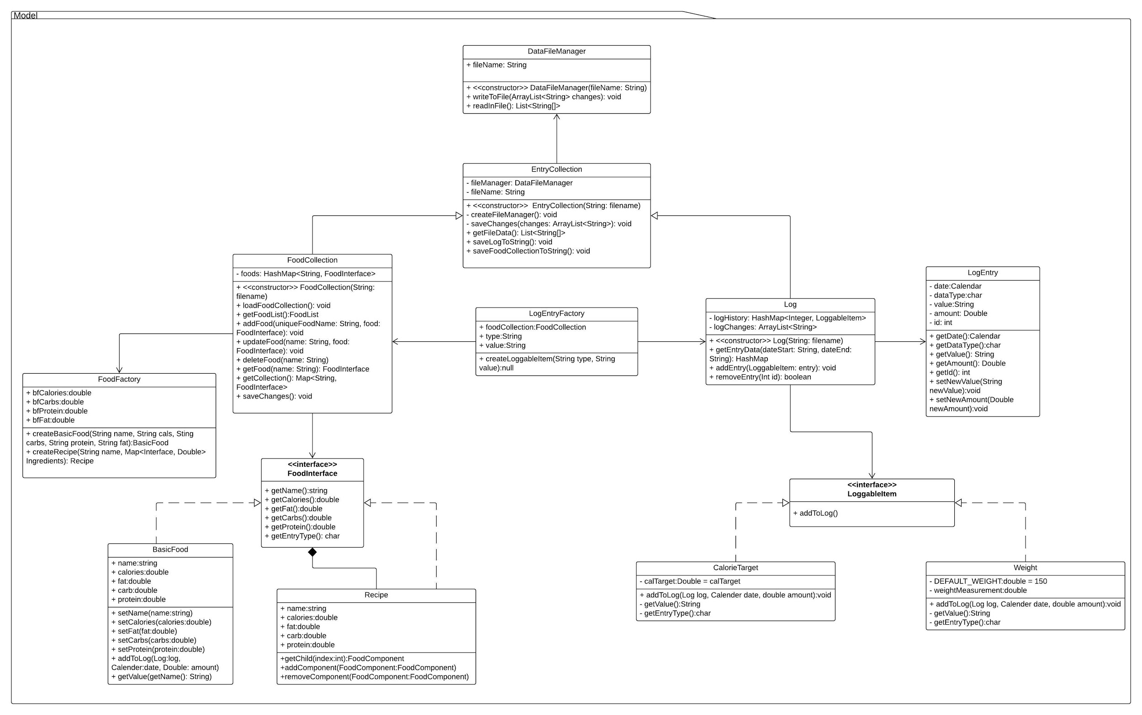
Model Subsystem Overview

Slide 3
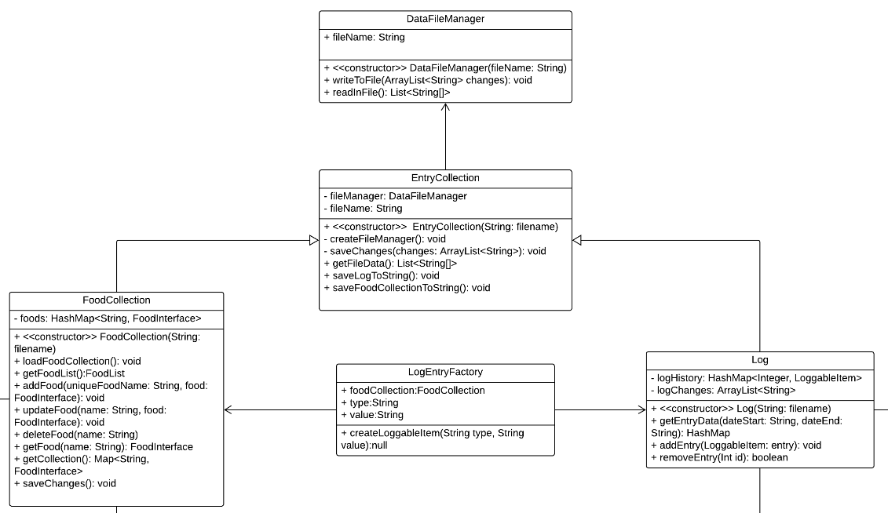
Model Subsystem - Zoomed In

Slide 4
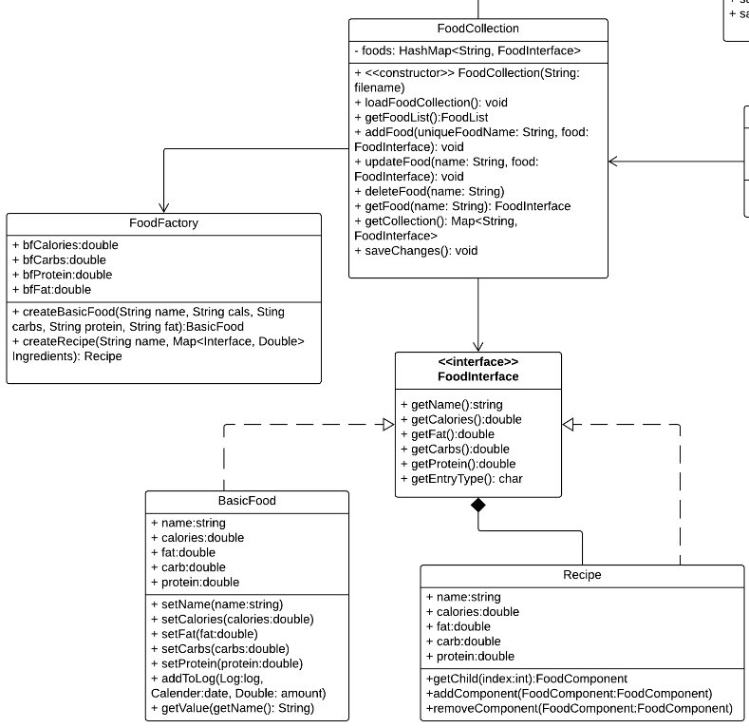
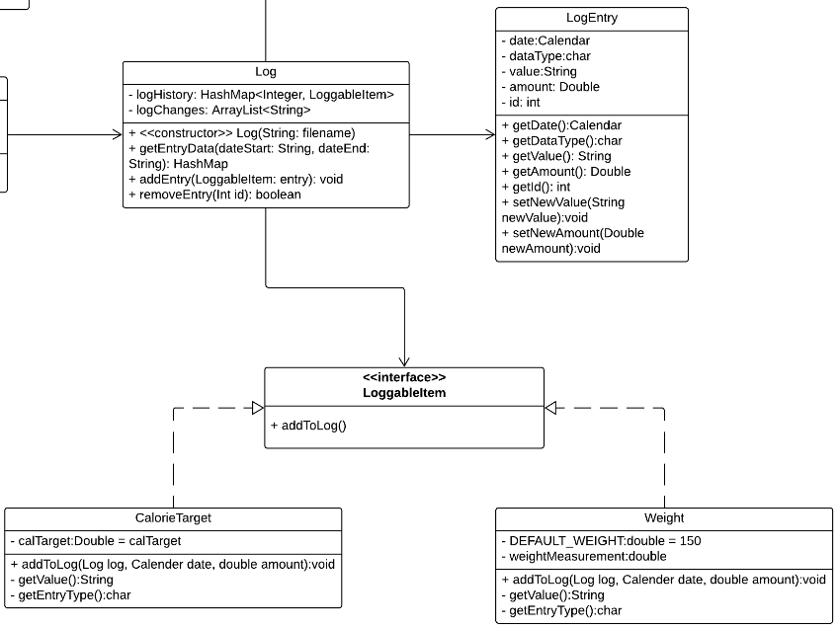
Model Subsystem - Zoomed In

Slide 5
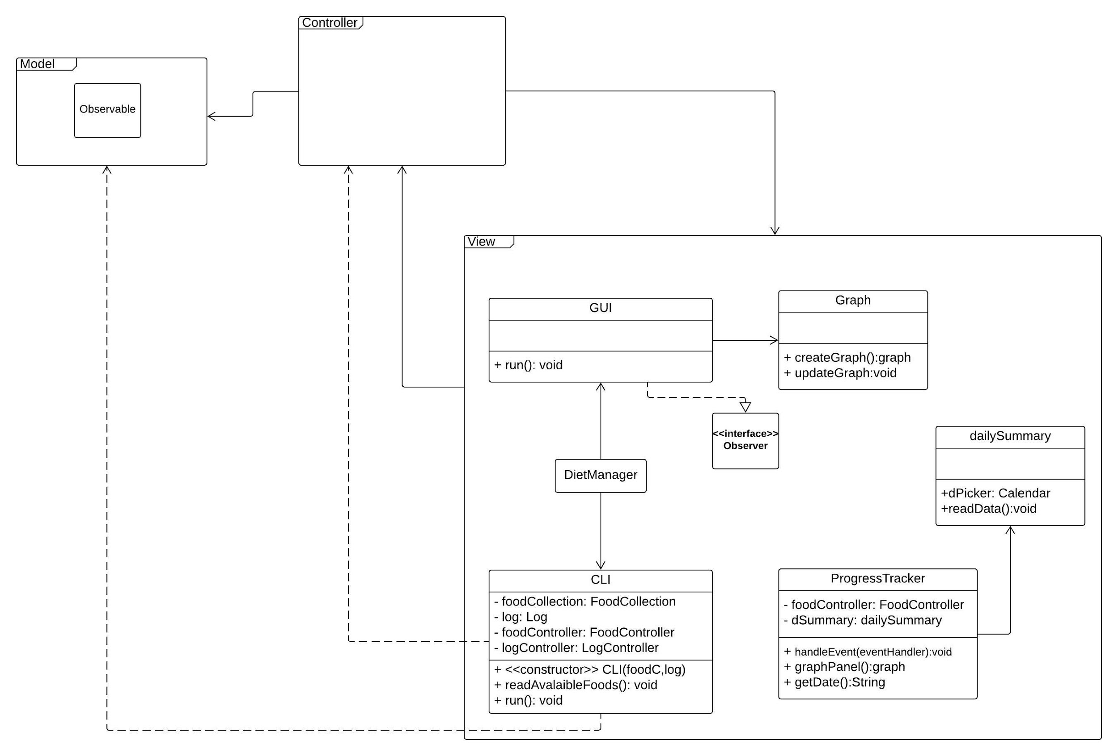
View Subsystem Overview

Slide 6
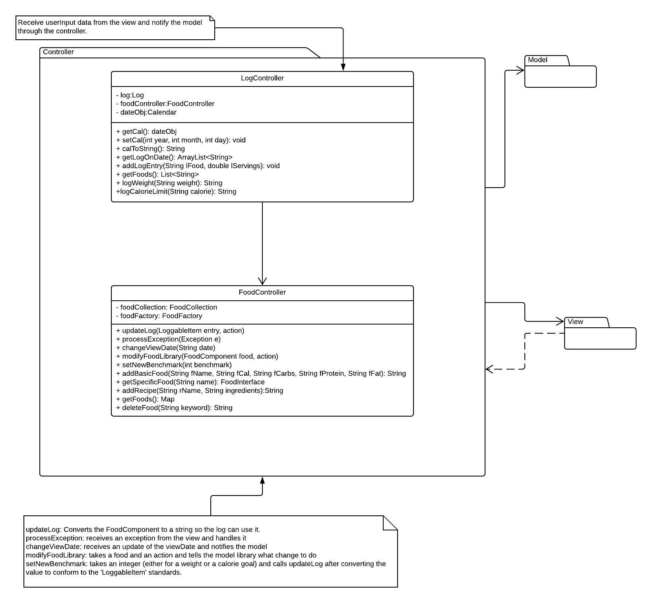
Controller Subsystem Overview

Slide 7
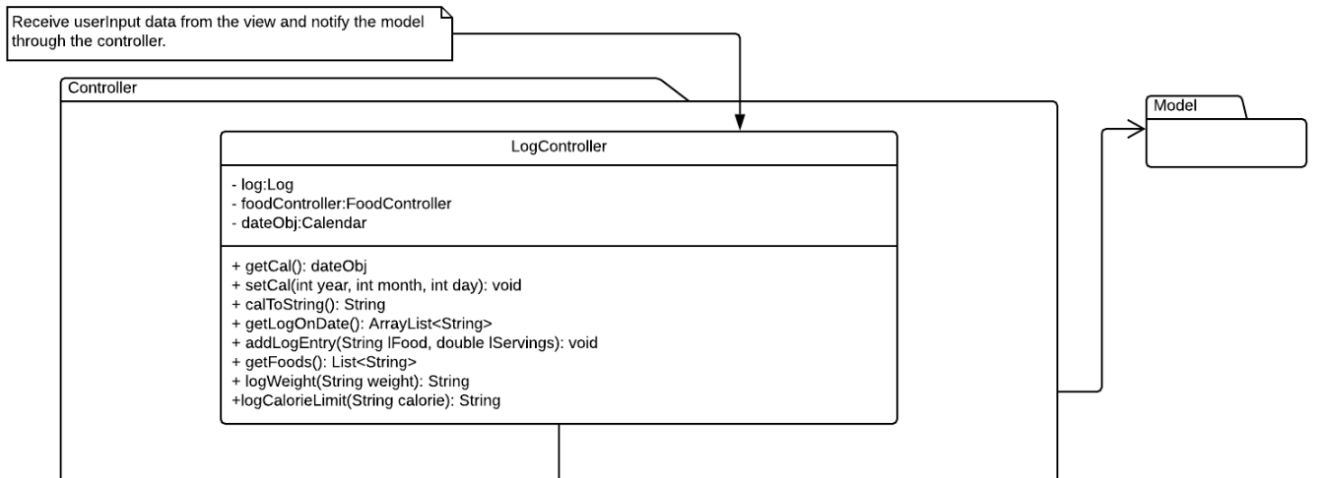
Controller Subsystem - Zoomed In

Slide 8
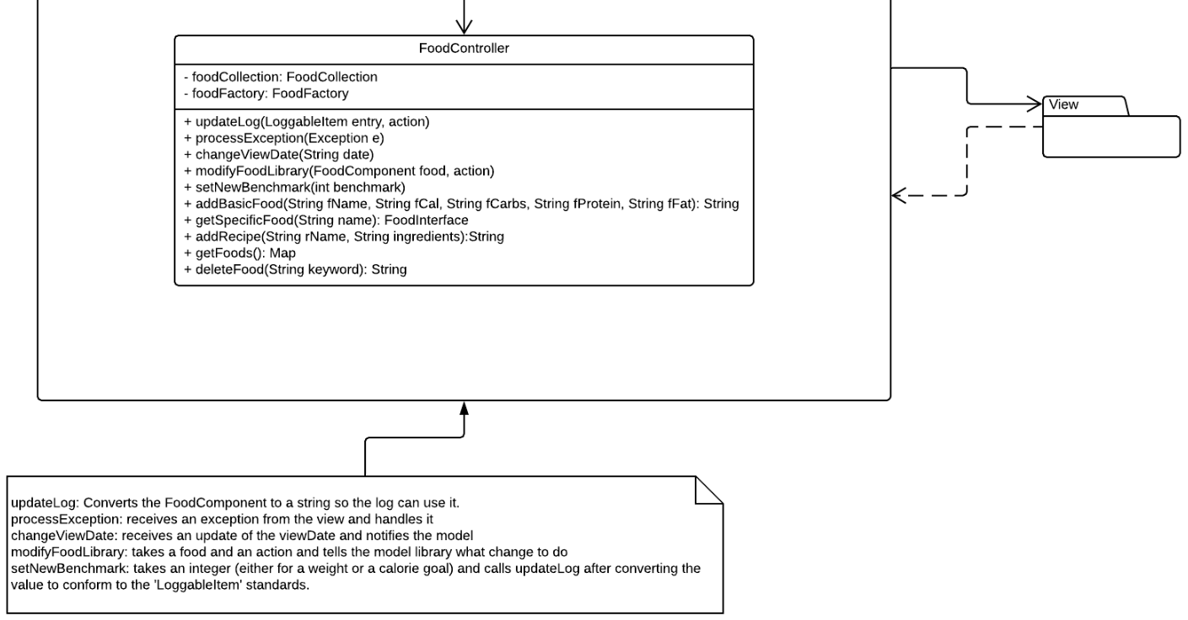
Controller Subsystem - Zoomed In

Slide 9
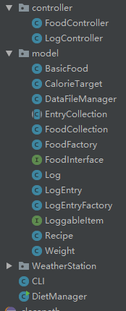
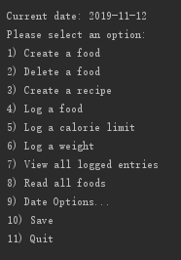
Menu & File Structure

Slide 10
Thanks for watching
Lowell Pence, Jack Old, Fred Amartey, Fengyi Chen

